Slide 1
CS 6476 Project 6
Haoran Wang
Haoran.wang@gatech.edu
hwang827
903543952

Slide 2
Parts 4 & 5: mIoU of different models
Add each of the following (keeping the changes as you move to the next row):
 | Training mIoU | Validation mIoU
Simple Segmentation Net (no pretrained weights) | 0.3992 | 0.2220
ImageNet-Pretrained backbone | 0.5101 | 0.4965
Data augmentation | 0.5447 | 0.4047
ImageNet-Pretrained PSPNet w/ Data Aug. without PPM | 0.4731 | 0.4529
PSPNet with PPM
PSPNet with auxiliary loss | 0.6228 | 0.6304

Slide 3
Parts 4 & 5: Per class IoUs
Report your model’s IoU for the 11 Camvid classes (you can find the order they are listed in at dataset_lists/camvid-11/camvid-11_names.txt):
Class Index | Class name | Simple Segmentation Net Class IoU | PSPNet Class IoU
0 | Building | 0.8148 | 0.8971
1 | Tree | 0.8530 | 0.9077
2 | Sky | 0.9219 | 0.9167
3 | Car | 0.7059 | 0.7926
4 | SignSymbol | 0.0000 | 0.0000
5 | Road | 0.8242 | 0.9489
6 | Pedestrian | 0.1685 | 0.3352
7 | Fence | 0.2041 | 0.7513
8 | Column_Pole | 0.0042 | 0.0061
9 | Sidewalk | 0.5607 | 0.8340
10 | Bicyclist | 0.4047 | 0.5444

Slide 4
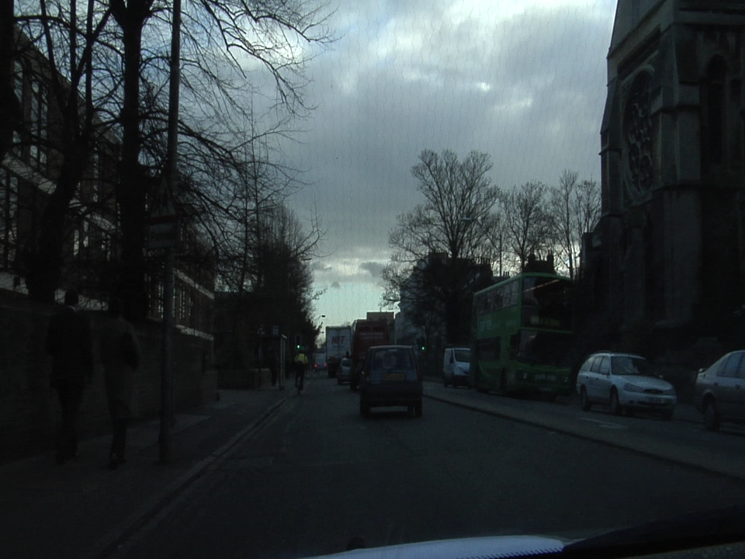
Parts 4 & 5: Most difficult classes
[Which classes have the lowest mIoU? Why might they be the most difficult? Provide an example RGB image from Camvid that illustrates your point]
SignSymbol and Column_Pole class has the lowest mIoU. Since both sign symbol and column poles are very thin and small. Especially our data has been down sampled and we have used dilation convolution.

Slide 5
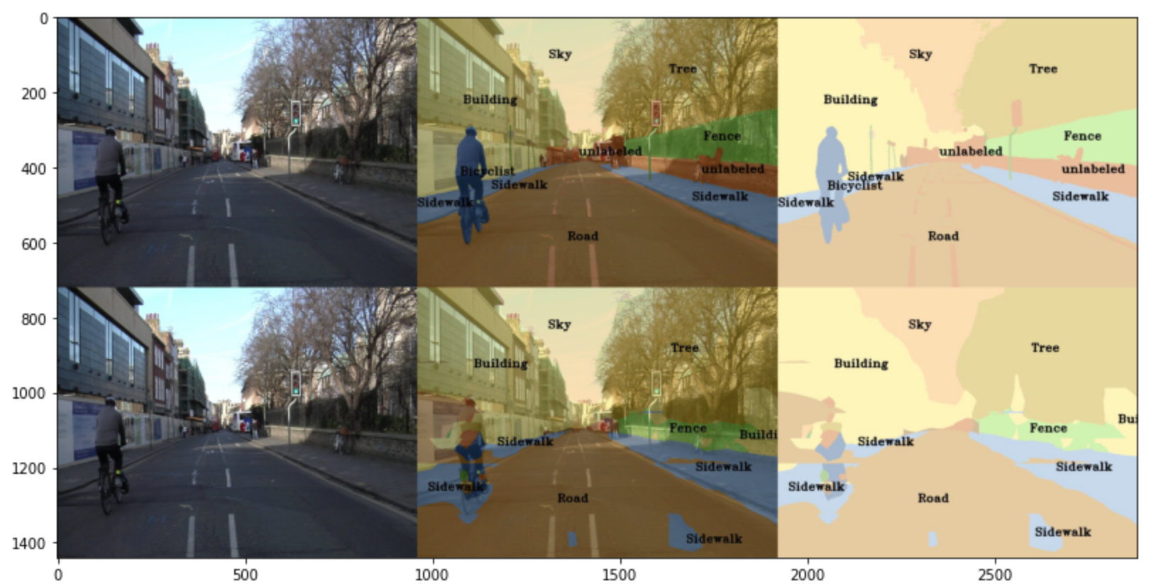
Part 4: Simple segmentation net qualitative results
[Paste a figure of the generated semantic segmentation from Colab. It should be a 2x3 grid, with ground truth on the top row, and your predictions on the bottom row.]

Slide 6
Part 5: PSPNet qualitative results
[Paste a figure of the generated semantic segmentation from Colab. It should be a 2x3 grid, with ground truth on the top row, and your predictions on the bottom row.]

